Slide 1

Molecular Epidemiologic studies based on a population-based cohort study and its potential use of early detection biomarker development
2017/3/6
Fourth Annual US Japan Workshop on Cancer Biomarkers in Collaboration with NCI Early Detection Research Network
Motoki Iwasaki
Division of Epidemiology,
Center for Public Health Sciences, National Cancer Center, Japan
1

Slide 2

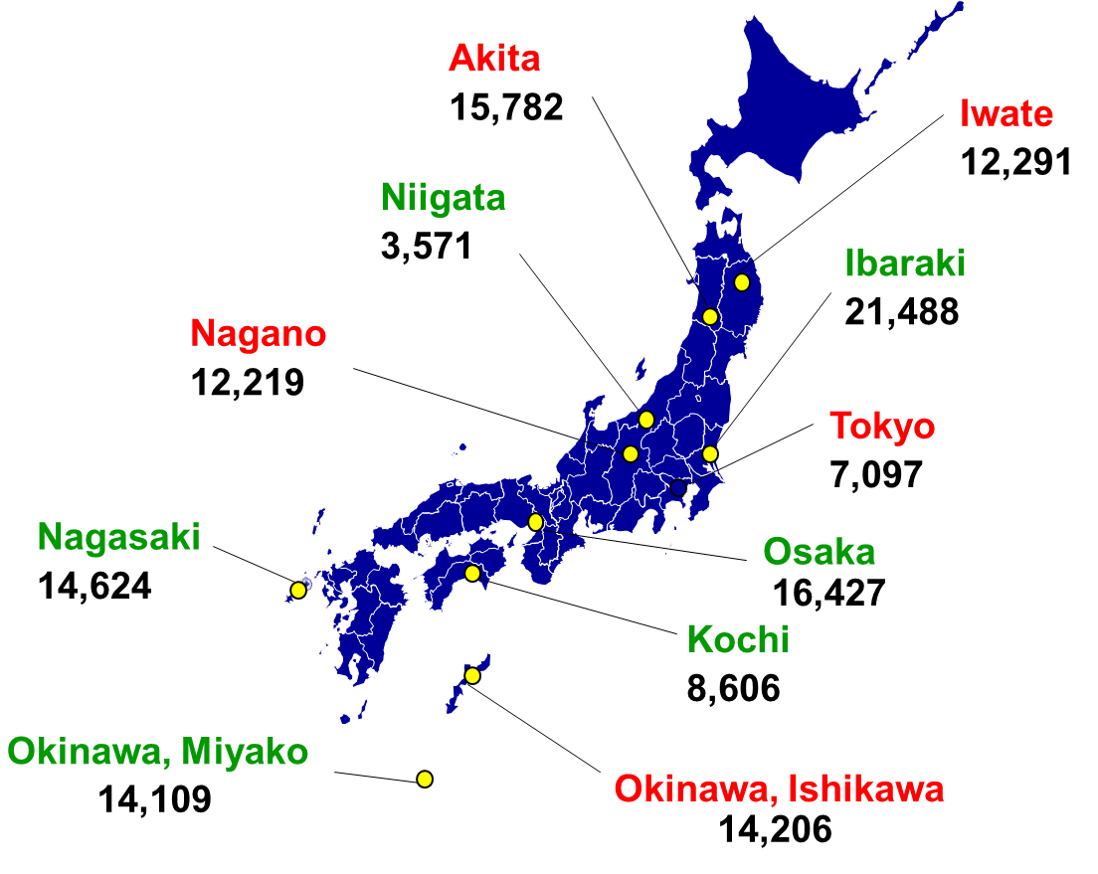
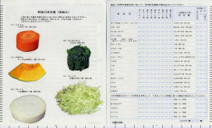
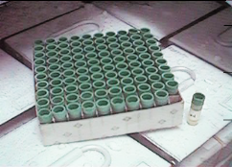
JPHC Study
Japan Public Health Center-based prospective Study
Subjects:140,420 people
(community residents
aged 40 to 69 years old)
Published original papers: 307 (update on April 2016)
Cancer ：130, Mortality：24
Cardiovascular diseases：45,
Diabetes：33
Baseline survey
(1990-94)
5 year follow-up survey
(1995-98)
10 year follow-up survey
(2000, 2003)
15 year follow-up survey
(2000, 20085)
Questionnaire
Blood sample
Health Check-ups
Questionnaire
Blood sample
Health Check-ups
Questionnaire
Questionnaire
Follow-up
1990
1995
2000
2005
2010
2015
2019
  Follow-up: move-out, cause of death, incidence of cancer, stroke, MI, and DM
Main outcomes (update on August 2016)
Mortality |  | 25,149
Incidence | Cancer | 18,222
 | Stroke | 6,225
 | Myocardial infarction | 1,224
Questionnaire (participation rate)
At least once 130,000 (90%)
All 80,000 (55%)
Blood sample
At least once 60,000 (43%)
Both 20,000 (17%)
2
Notes:
The Japan Public Health Center-based prospective Study conducted a baseline survey for 140 000 registered residents aged 40-69 years within 11 public health center areas nationwide in 1990-94. Five- and 10-year follow-up surveys were conducted to update information on lifestyle habits and health conditions. In total, 130,000 participants responded to at least one of the three questionnaire surveys, and 80,000 to all three. In addition, 60,000 participants provided blood samples on at least one of the two sampling times, and 20,000 on both. The subjects have been followed for vital status and the occurrence of cancer and other diseases. As of July 2016, 25,000 deaths have been documented, as well as 18,000 cases of cancer, 6000 cases of stroke and 1200 cases of myocardial infarction. We have tested the association between potential causal factors and the incidence of or mortality from cancer and other diseases, and published 300 papers to date.

Slide 3

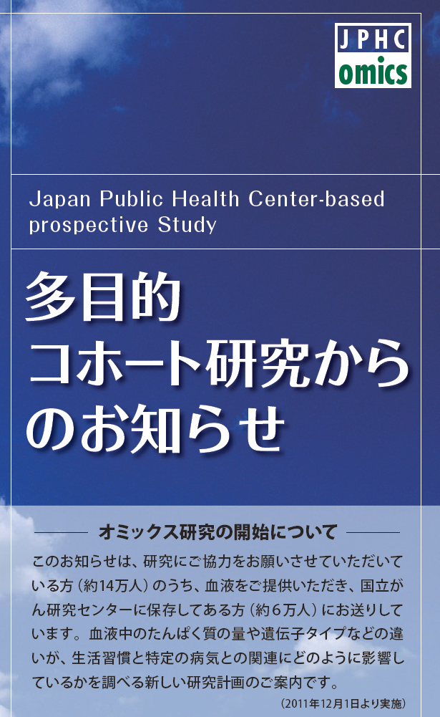
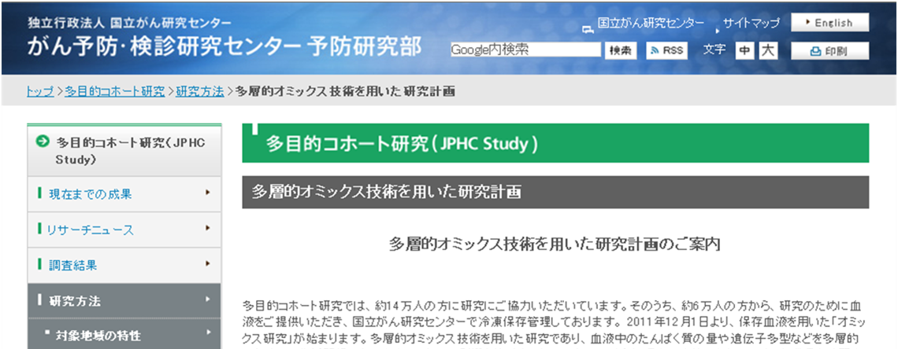
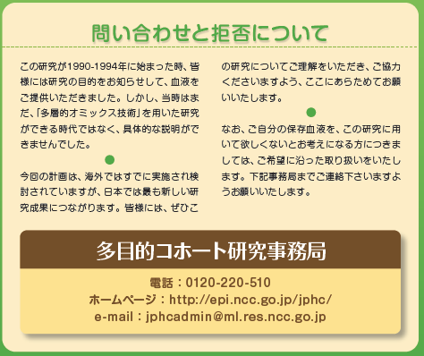
Multi-omics analysis in the JPHC study
Institutional review board approved our protocol on August 30, 2011
Send a newsletter for the omics analysis
Provide an opportunity to refuse to use samples
Disclosure of the omics analysis by website
3

Slide 4
Nested case-control design
Move-out
Questionnaire
Death
Blood sample
Stomach cancer
Control is selected at the time of occurrence of case
Alive
Lung cancer
Only case-control pairs are used for measuring blood samples
Stomach cancer
Alive
Colorectal cancer
Death
Stomach cancer
Lung cancer
Stomach cancer
Alive
Alive
Baseline survey
Follow-up
4
Notes:
対照群は、母集団における曝露の人時分布を反映するように標本抽出される。標本抽出が、曝露と無関係に行われた場合、症例対照研究は発生率比の妥当な推定値を示せる。
曝露集団の発生率 I1=a/PT1
非曝露集団の発生率 I0=b/PT0
サンプリングの際には、曝露群と非曝露群の人時総量の割合の推計と対照群が示す必要がある。つまり対照群として曝露群がc人、非曝露群がd人含まれていたとしたら、c/d = PT1/PT0となるように対照群を選択すること。
相対リスク I1/I0 = (a/PT1)/(b/PT0) = a/b * PT0/PT1 = a/b * d/c
母集団全体で経験される人時を測定せず、分母の標本を使用する場合、どのような欠点があるか？その一つは、母集団の標本抽出では不正確な曝露分布の指標しか得られず、その結果、誤った推定値になるかもしれない点がある。

Slide 5

Association between alcohol consumption, ADH1B, ADH1C and ALDH2 polymorphisms, and gastric cancer risk
P trend =0.64
1.00
0.73
1.00
0.91
Alcohol consumption
ADH1B (rs1229984)
1.00
0.79
1.00
1.16
ADH1C (rs698)
ALDH2 (rs671)
5
Hidaka A, et al. Carcinogenesis 2015;36:223-31.

Slide 6
Effect modification of ADH1B, ADH1C and ALDH2 polymorphisms on gastric cancer risk associated with alcohol consumption
P for interaction =0.76
P for interaction =0.02*
P for interaction =0.08
ADH1B (rs1229984)
ADH1C (rs698)
ALDH2 (rs671)
*<0.05
6
Hidaka A, et al. Carcinogenesis 2015;36:223-31.

Slide 7
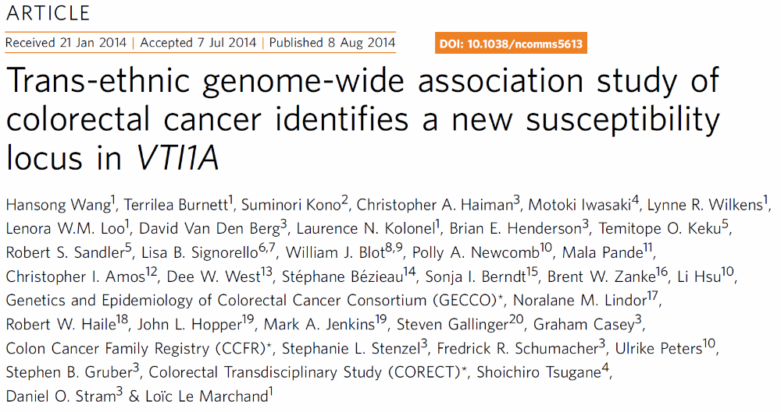
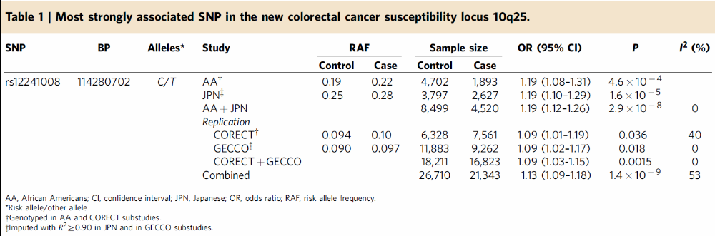
Genome-wide association study of colorectal cancer collaboration with Dr. Le Marchand (Univ. of Hawaii)
Wang H, et al. Nat Commun. 2014;5:4613.
7

Slide 8
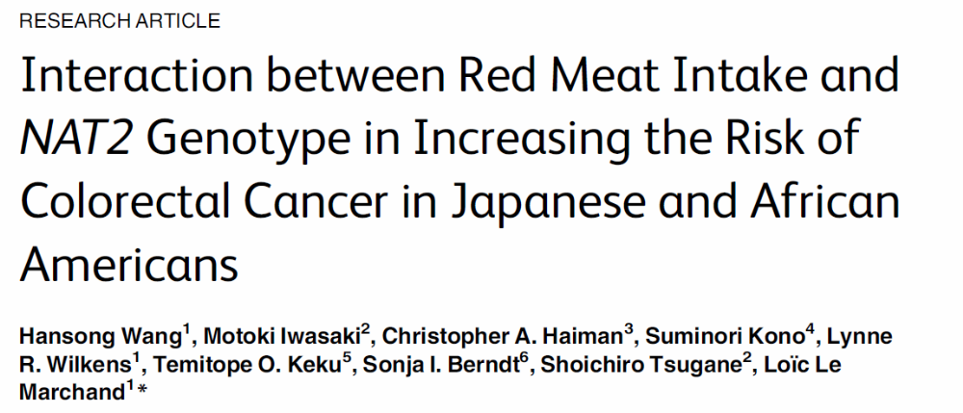

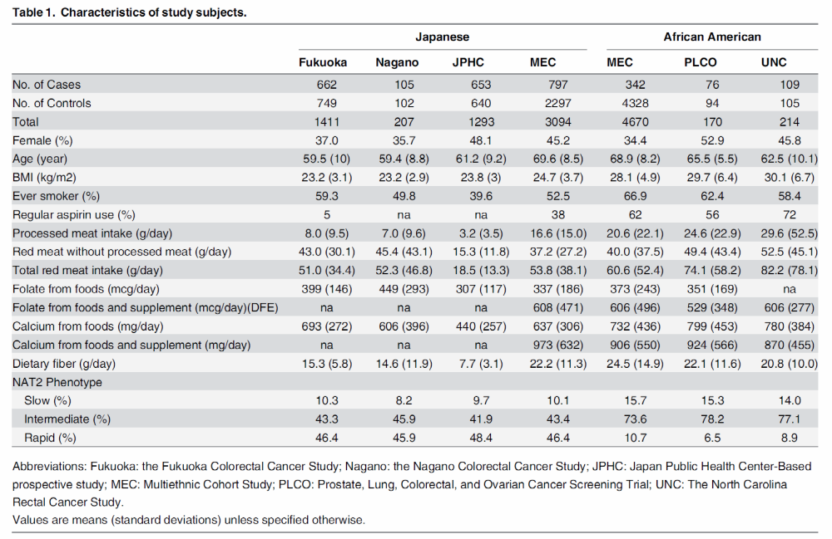
Wang H, et al. PLoS One. 2015;10:e0144955
8

Slide 9
Association of Processed meat intake with Colorectal Cancer Risk, Stratified by NAT2 genotypes
Japanese
African American
P_{interaction} =0.044
P_{interaction} =0.018
Wang et al. PLoS One. 2015;10(12):e0144955.
9

Slide 10
Case-cohort study for total cancer risk (conceptual diagram)
Cancer cases
3,750 diagnosed cancer cases
until 31 December 2009
Follow-up period:
19 years
2,235 cancer cases from the rest of 20,712 subjects
1,515 cancer cases from the subcohort
Cohort
Subcohort
The subjects who responded to the questionnaire and provided blood samples at baseline (n = 33,736 subjects) after exclusion of subjects in Tokyo and Osaka and ineligible subjects.
We randomly selected 13,024 subjects as a subcohort, stratified by sex, age, and area
10

Slide 11
Case-cohort study of total cancer
 |  |  | Men | Women | Total | Genotyping
Baseline survey (Questionnaire + Blood samples) |  |  | 11,883 | 21,068 | 32,951
 | Sub-cohort (for plasma measurement) |  | 4,573 | 8,153 | 12,726 (4456) | SNP typing (OMNI2.5, Express, ExpressExome)
 |  | Total cancer incident cases | 2,028 | 1,722 | 3,750 | SNP typing (ExpressExome)
 |  | Description
 |  | Stomach | 497 | 285 | 782
 |  | Colorectal | 386 | 362 | 748
 |  | Lung | 338 | 172 | 510
 |  | Prostate | 335 | 0 | 335
 |  | Breast | 3 | 263 | 266
 |  | Liver | 119 | 75 | 194
 |  | Pancreas | 66 | 81 | 147
Case-cohort study
Case
After exclusion of subjects in Tokyo and Osaka, ineligible subjects, and subjects with history of cancer. Follow-up by the end of 2009.
11

Slide 12
Ongoing projects using data from a case-cohort study of total cancer
Etiologic studies
  Replication studies for GWAS identified SNPs in Japanese
  Gene-environment interaction
    Replication studies for reported interactions by candidate approach
      e.g. alcohol intake, polymorphisms in genes related to alcohol metabolism, and risk of cancer
    Studies for identifying novel interactions
      Genome-wide G×E interaction scan (GWIS)
  Assessment of causality by Mendelian randomization (MR)
    Estimate the unbiased, unconfounded effect of exposure on cancer risk
  GWAS of quantitative traits (e.g. BMI, biomarkers) using sub-cohort
    Determine candidate SNPs as instrumental variables for MR
Prevention studies
  Absolute risk estimation by risk prediction model
    Improve by incorporation of genetic factor into an epidemiologic model?
12

Slide 13
Ongoing projects using plasma samples
Nested case-control study (since December 2002)
Outcome | No. of cases and controls | Measurement
Stomach | 512: 512 | Helicobacter pylori (IgG, CagA), pepsinogen, polyphenols, carotenoids, inflammatory markers, C-peptide, IGF hormones, total ROS
Colorectal | 375 : 750 | Folate, c-peptide, IGF hormones, vitamin D, inflammatory markers, adipokines
Breast | 144 : 288 | sex hormones, isoflavones, organochlorine compounds
Prostate | 201 : 402 | sex hormones, isoflavones, organochlorine compounds, PSA, c-peptide, vitamin D
Lung | 126 : 252 (women) 258 : 516 (men) | isoflavones
Liver | 90 : 177 | Adipokines, isoflavones
Pancreas | 170 : 340 | c-peptide, IGF hormones, inflammatory markers, adipokines
Stroke Myocardial infarction | 1134 : 1134 209 : 317 | polyphenols, homocysteine, inflammatory markers, Helicobacter pylori (IgG, CagA), fatty acids, chlamydia
Diabetes mellitus | ① 1241 : 1848 ② 718 : 1026 | Adipokines, SHBG
Sub-cohort study
Outcome | No. of subjects | Measurement
virus-associated cancer | About 20,000 | hepatitis associated virus (HBV, HCV), HTLV-I, Helicobacter pylori (IgG, CagA), pepsinogen
13
Notes:
胃がん： 2004年末： 国循含む（吹田除く）
大腸がん： 2003年末： 大阪含む
乳がん： 2002年末： 大阪含む
前立腺がん： 2005年末： 大阪含む
肺がん： 2006年末： 大阪含む
男性はピックアップしていない：症例262人、対照は524人または786人（786人または1048人）
女性は合計378人
膵がん：
循環器：
○2006年サンプリング分の進捗
脳卒中（１：1マッチング） ：608症例、608対照 ：合計1216人
心筋梗塞（１：2マッチング） ：108症例、216対照 ：合計324人
上記の対象者から重複しているケースを除く合計1493検体
脳卒中：535ペアで1070検体
心筋梗塞：90ペアで270検体
重複分：153検体
○2008年サンプリング分の進捗
脳卒中（１：1マッチング） ：526症例、526対照 ：合計1052人
心筋梗塞（１：2マッチング） ：101症例、202対照 ：合計303人
心筋梗塞の症例の半数はsudden cardiac deathで純粋な心筋梗塞は半数。
マッチング条件は前回と同じだが、重複なしで対象者を抽出（2008/07/11測定リスト）
13

Slide 14
Plasma insulin, C-peptide, and blood glucose level
and gastric cancer risk stratified by sex
Men
Women
* p<0.05
P trend: 0.01*
P trend: 0.03*
P trend: 0.98
P trend: 0.56
P trend: 0.23
P trend: 0.19
Insulin
C-peptide
Blood glucose
Insulin
C-peptide
Blood glucose
14
Hidaka A, et al. Int J Cancer 2015;136:1402-10.
Notes:
結果です。男女別に解析すると男性で、第1分位：低値と比較して第3分位：高値でインスリンは約2.5倍、C-ペプチドで約2倍の胃がんのリスク上昇を認めました。血糖値は胃がんとの関連は見られず、また女性ではすべての糖尿病関連血漿マーカーで関連を認めませんでした。

Slide 15
Baseline survey
Follow-up
Questionnaire
Blood samples
Years between blood collection and time of diagnosis
5 years
10 years
15 years
Association by the follow-up period
Presence of cancer influence association
= diagnostic marker
Consistent by the follow-up period = risk or predictive factor
15

Slide 16
Plasma insulin, C-peptide, and blood glucose level and gastric cancer risk
stratified by the follow-up periods of gastric cancer in men
* p<0.05
GC diagnosed in the first 0-6 years of follow-up
GC diagnosed in the first 6-14 years of follow-up
P trend: 0.04*
P trend: 0.16
P trend: 0.35
P trend: 0.11
P trend: 0.14
P trend: 0.39
Insulin
C-peptide
Blood glucose
Insulin
C-peptide
Blood glucose
16
Notes:
これは男女合わせた結果です。今回検討した糖尿病関連マーカーは食事の影響を強く受けるため、空腹時：食後≧8時間でも解析しました。空腹時においても統計学的に有意ではありませんでしたが、第1分位：低値と比較して第3分位：高値でインスリン、C-ペプチド、HOMA-βで胃がんリスクの上昇を認めました。HOMA-IR値においても1.73未満と比較して1.73以上で約2倍の胃がんリスク上昇を認めました。
もう一度HOMAの説明。なんで測定したか、意味するもの
空腹時血糖も口頭で説明
（食後8時間未満においても第1分位：低値と比較して第3分位：高値でインスリン、C-ペプチドは弱い胃がんリスクの上昇を認めました。）

Slide 17
Nested case-control study of pancreatic cancer
Matching conditions
  Sex, age (5-year category), area (public health center), fasting time (less than or more than7 hours)
Number of subjects
  170 cases, 340 controls (150 cases and 300 controls for use of DNA)
Analysis
  Genome wide association study: Ilumina OMNI Express
  Methylome analysis: Infinium HumanMethylation 450K
  Proteome analysis: diagnostic markers
    Apolipoprotein by Dr. Honda at NCCRI
    Prolyl-hydroxylated alpha-fibrinogen by Dr. Ono at NCCRI
  Metabolome analyses:
17

Slide 18
Proteome analysis: diagnostic markes
Hypothetical example
Biomarker X (unit)
Follow-up period (year)
18

Slide 19
Summary
The JPHC study is ongoing cohort study
  Repeated questionnaire data and plasma and DNA samples
  Multi-omics analysis in the JPHC study has conducted.
    Several published papers for gastric cancer and colorectal cancer
    A case-cohort study of total cancer is ongoing.
  Nested case-control studies using plasma samples have conducted.
    Observed associations indicate predictive or risk markers.
    Analyses by follow-up period might be useful for investigating diagnostic markers.
19

Slide 20
Thank you for your attention.
20
Notes:
20

